Slide 1
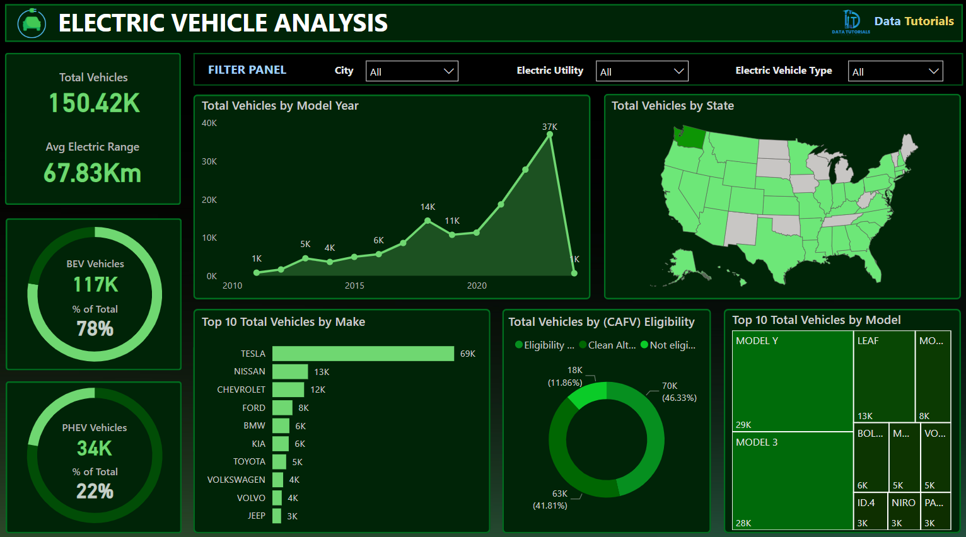
PROBLEM STATEMENT
A US Based Ecommerce Sales company wants us to create a Sales dashboard showing information of YTD sales and generate insights for below scenarios.
Create a KPI Banner showing YTD Sales, YTD Profit, YTD Quantity Sold, YTD Profit Margin
Find Year on Year Growth for each KPI and show a YTD spark line for each measure in the KPI to understand the monthly trend for each fact.
Find YTD Sales, PYTD sales, YOY sales growth for different customer category. ADD a trend icon for each category.
Find YTD sales performance by each state.
Top 5 and Bottom 5 products by sales.
YTD sales by region to know best and worst performing region all over country.
YTD sales by shipping type to get the best shipping type percentage.

